Slide 1
October 2022
EMPLOYEE ENGAGEMENT SURVEY

Slide 2
Karri Wilson
completed her Ph.D. in Social Work in 2009 from the University of Missouri. Her doctoral studies focused on the subject of Employee Engagement. Research on the topic led her to develop and copy write a survey instrument designed to measure the level of engagement for employees who work in public human services agencies. Continued research and study has led to Karri being asked to present on the topic of Engagement at events around the United States and to her consulting on Engagement with multiple state Vocational Rehabilitation programs. Karri has been employed by Missouri Vocational Rehabilitation since 1994. She began her career as a VR Counselor, was promoted to District Supervisor, then to Regional Manager and she now serves as Coordinator of Client Services for Missouri Vocational Rehabilitation.

Slide 3
What is Employee Engagement?
Engaged employees identify with the agency mission, feel empowered, and are willing to commit the emotional and personal energy necessary to excel in their work. They drive innovation and move the organization forward.

Slide 4
Research defines three categories
Engaged employees are the best colleagues. They cooperate to build an organization, and they are behind everything good that happens there. These employees are involved in, enthusiastic about, and committed to their work. They know the scope of their jobs and look for new and better ways to achieve outcomes. They are 100% psychologically committed to their work. They are the people in the organization who create new customers.
Not engaged workers can be difficult to spot: They are not hostile or disruptive. They show up and put time, but not energy or passion into their work. They show little or no concern about customers, productivity, profitability, waste, safety, mission and purpose of the teams, or developing customers. They are thinking about lunch or their next break. They are essentially “checked out.” Surprisingly, these people are not only a part of your professional staff, but they are also sitting on your executive committee.
Actively Disengaged employees aren’t just unhappy at work; they’re busy acting out their unhappiness. Every day, these workers undermine what their engaged coworkers accomplish.

Slide 5
Risky Business
Serious risks associated with not having Engaged Employees
Decreased customer satisfaction
Poor performance on crucial tasks
Increased cost of doing business
Disengaged workers can actually turn other workers against the organization
Higher turnover rates
Disengaged workers monopolize managers’ time
More on the job accidents

Slide 6
What can the agency do?
1: Engagement starts at the top: Senior leadership must buy in
2: Educate front line supervisors
3: Implement Engagement strategies
4: Survey staff
Repeat! Engagement is not a one and done

Slide 7
Survey Instrument
Developed in 2008 for dissertation in the Social Work PhD program at University of Missouri
Instrument developed from industry research on Engagement
Instrument was designed specifically for human services workers
Instrument was pilot tested and confirmed reliable/valid
8 Questions based on the three major components of EE:
  Meaningfulness – Q: 1,3,5
  Safety – Q: 2, 4,7
  Availability – Q: 6,8

Slide 8
Survey Implementation
Email sent to every employee with information about the survey and a request to participate – be mindful of who sends out the email – MO response rate over 65%
Email contains a link to the survey in SurveyMonkey
Allow 2 weeks to participate – with one or two reminders sent
Survey takes average 5 minutes to complete with additional time for open ended question

Slide 9

SurveyMonkey
Sit back and gather the data

Slide 10
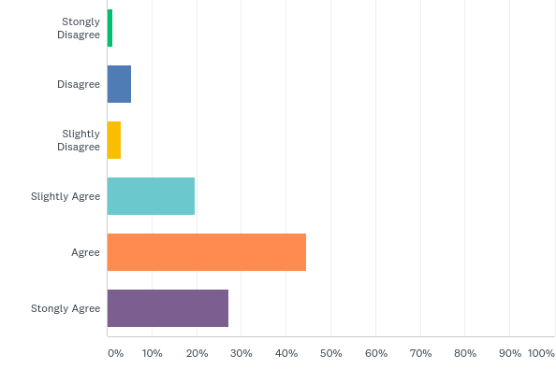
Q1: I have received recognition for doing my job well

Slide 11
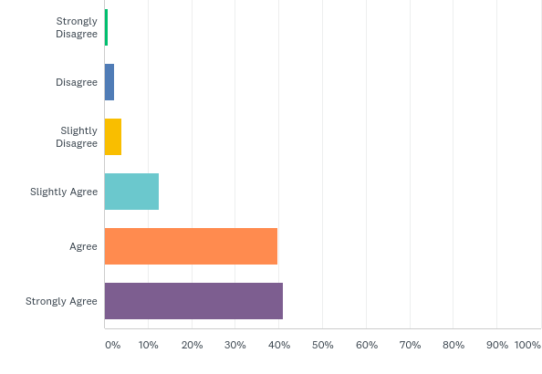
Q2: My supervisor seems concerned about my welfare

Slide 12
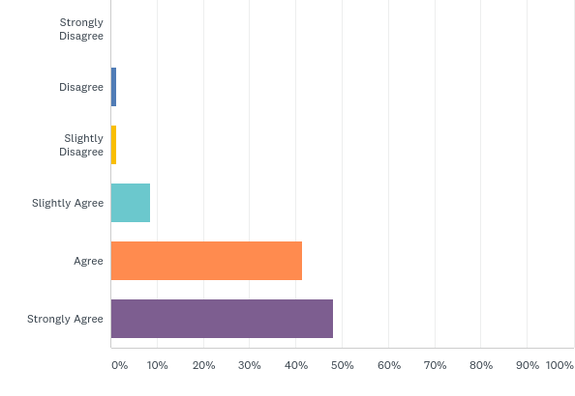
Q3: The mission of the agency makes me feel like the work I do matters.

Slide 13
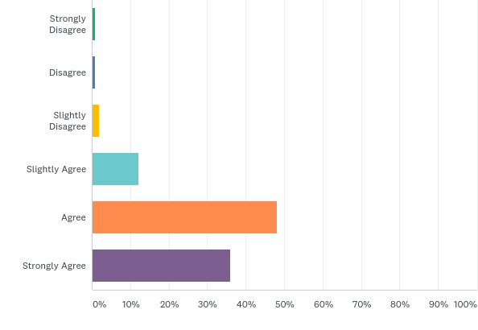
Q4: I have friends at work

Slide 14
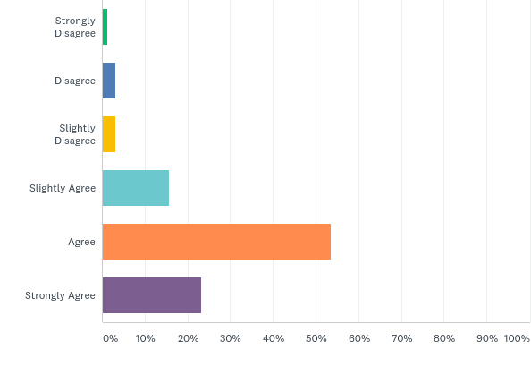
Q5: While on the job, my ideas and opinions are taken seriously.

Slide 15

Q6: The materials, tools, and equipment that I need to do my job are supplied by the agency and made readily available to me.

Slide 16
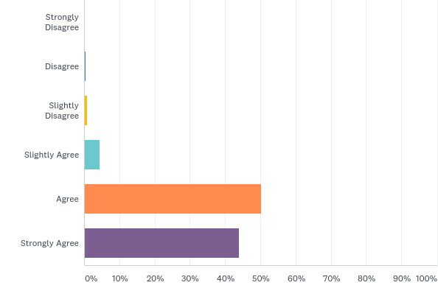
Q7: The people I work with do a good job

Slide 17
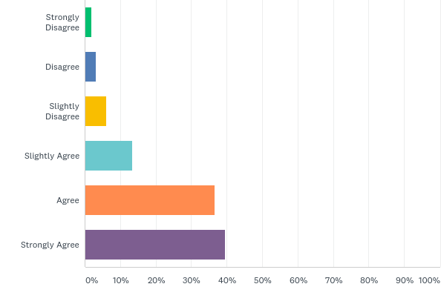
Q8: I will still be employed here two years from now

Slide 18
Would you like to give additional information about your responses?
Open ended

Slide 19
Demographic Information
How many years have you worked for the agency?
  0 to 5 years_____; 6 to 10 years_____; 1 to 15 years_____; 6 to 20 years_____; Over 20 years____
Is your office located in: Kansas City or St. Louis _______ Other _________
Indicate your position: Professional Staff ____ Support Staff ____
Do you supervise anyone? Yes_____ No_____
What is your age? 18 – 23 _____ 24 – 29 _____ 30 – 35_____ 36 – 41 _____ 42 – 47_____ 48 – 53_____ Over 53
____ Male _______ Female________

Slide 20
Survey Calculations
Each response option is assigned a numerical value
1= Strongly disagree
2 = Disagree
3 = Slightly Disagree
4 = Slightly Agree
5 = Agree
6 = strongly agree
Each participant receives a score from low of 8 to high of 48

Slide 21
What do the numbers mean?
A score lower than 32 is “not engaged”
A score 32 or above is “engaged”
A score of 40 and above is “highly engaged”

Slide 22
Then What? In Missouri we:
Survey every two years
Results calculated
Open ended responses reviewed for themes
Report shared with Executive Leadership
Report shared with front line supervisors
2022 results shared on End of program year accomplishments handout

Slide 23
Agency Action
What do we like about the survey?
Administering every two years gives us constant pulse of how people “feel” about working for MO VR
Highlights trends
Provides direction for initiatives
What have we done?
Cell Phones for Staff
Annual conference for support staff
Quarterly statewide call
Focus on workday flexibility

Slide 24
Contact
To Schedule an Engagement Workshop or to use the Engagement Survey contact:
Karri Wilson
karen.wilson@vr.dese.mo.gov
660-530-5560

